Slide 1
Digital Portfolio
STUDENT NAME: T. LALITHA
REGISTER NO AND NMID: 24134031802522023
DEPARTMENT: B.SC COMPUTER SCIENCE
COLLEGE: PSPT MGR GOVERNMENT ARTS & SCIENCE COLLEGE

Slide 2
PROJECT TITLE
APP DEVELOPMENT JOURNEY

Slide 3


AGENDA
Problem Statement
Project Overview
End Users
Tools and Technologies
Portfolio design and Layout
Features and Functionality
Results and Screenshots
Conclusion
Github Link
3/21/2024 Annual Review

Slide 4
PROBLEM STATEMENT
A problem statement for an app development journey clearly defines the user's pain point, the impact of the problem, and the desired outcome of the solution It is a human-centered approach that guides the development process and ensures the final product addresses a real-world issue, rather than being just a list of features.

Slide 5

PROJECT OVERVIEW
structured, multi-stage process that begins with a clear app idea and ends with a functional, supported application, involving phases like strategy, design, development, testing, deployment, and ongoing maintenance

Slide 6

WHO ARE THE END USERS?
I the individuals who will directly use the application to perform tasks or achieve goals,

Slide 7

TOOLS AND TECHNIQUES
The app developer journey involves strategic planning, a multi-phase development process, and ongoing maintenance, using a range of specialized tools and techniques for each stage

Slide 8
POTFOLIO DESIGN AND LAYOUT
should have a clear layout, showcasing your best projects with detailed descriptions, live links, and code samples
8

Slide 9
FEATURES AND FUNCTIONALITY
robust user authentication, intuitive navigation, core app features aligned with business goals, seamless performance, and strong security measures.

Slide 10
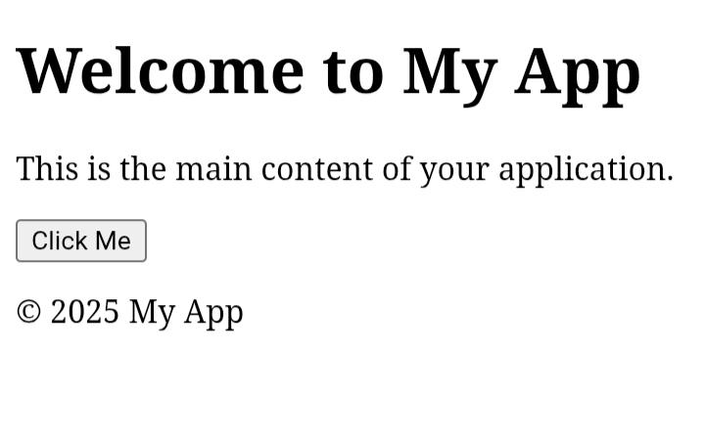

RESULTS AND SCREENSHOTS
3/21/2024 Annual Review
10

Slide 11
CONCLUSION
Conclusion: The app development journey is a structured process that transforms an idea into a functional and user-friendly application. It begins with problem identification and planning, moves through design, coding, and testing, and finally reaches deployment and maintenance. Each stage is crucial for ensuring performance, usability, and scalability. The journey not only requires technical skills but also creativity, teamwork, and continuous improvement. Ultimately, successful app development delivers value to users while achieving the intended business or personal goals
11

